Slide 1
Understanding Sitemaps
Sitemaps are divided into two broad categories:
those created for human users
those specifically created for search engine crawlers.

Slide 2
Understanding Sitemaps
Sitemaps help your visitors quickly get to the information they need, and they help web spiders find your site’s links.
Reasons for using Sitemaps
Crawl augmentation
Poor linking site structure
Crawling frequency
Content ownership
Page priority
Large sites
History of changes

Slide 3
Understanding Sitemaps
XML Sitemaps
XML Sitemaps are written only for web spiders
They are collections of links with their respective (optional) attributes formatted according to the XML schema.
XML Sitemap Format
Each link in an XML Sitemap can have up to four attributes.
loc
lastmod,
changefreq,
priority.

Slide 4



Understanding Sitemaps
XML Sitemap Format

Slide 5
Understanding Sitemaps
XML Sitemaps
Attribute |  | Description
<urlset> | required | Encapsulates the file and references the current protocol standard.
<url> | required | Parent tag for each URL entry. The remaining tags are children of this tag.

Slide 6
Understanding Sitemaps
XML Sitemaps
<loc>
Represent actual URL or link value.
Note that the http part is mandatory.
Also note that the URL should not be longer than 2,048 characters, as this is a known URL length limit for some of the server platforms.

Slide 7

Understanding Sitemaps
XML Sitemaps
<lastmod>
represents the time and date when a particular link was last modified.
The lastmod attribute tag has two data value formats.
short form without the time part and
the long form with the full date and time

Slide 8
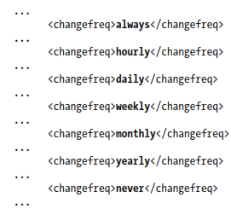
Understanding Sitemaps
XML Sitemaps
<changefreq>
Represents a hint as to how often a particular link might change.

Slide 9
Understanding Sitemaps
XML Sitemaps
<priority>
The priority attribute tag is perhaps the most important of all the optional link attributes.
Its values range from 0.0 to 1.0.
The median or default value for any page is signified by a value of 0.5.

Slide 10
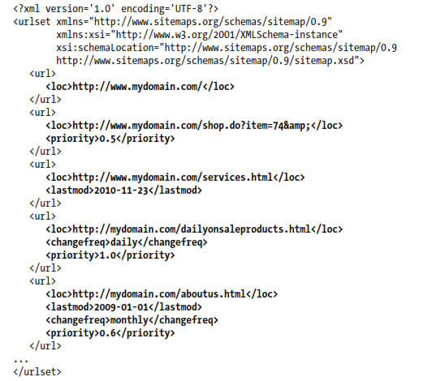
Understanding Sitemaps
XML Sitemaps

Slide 11
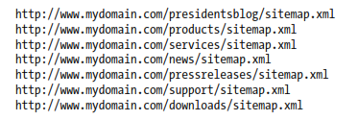
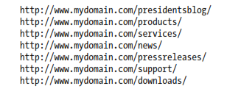
Understanding Sitemaps
XML Sitemap Auto-Discovery
Sitemaps are now discovered within robots.txt.
Multiple XML Sitemaps
Create the XML Sitemap Index file

Slide 12
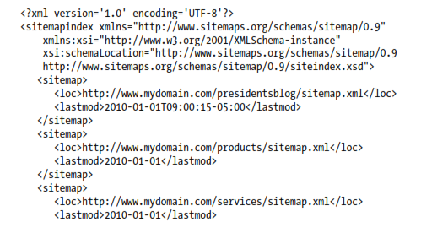
Understanding Sitemaps
Multiple XML Sitemaps

Slide 13
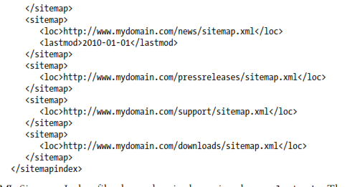
Understanding Sitemaps
Multiple XML Sitemaps

Slide 14
Understanding Sitemaps
Sitemap Location and Naming
XML Sitemaps can refer only to files in the folder in which they are placed, or files located in any child folders of that folder.
The recommended name is sitemap.xml.

Slide 15
Keyword Research

Slide 16
Keyword Strategy
Sound SEO calls for a sound keyword strategy.
You need to know what keywords you should target.
Creating new pages with arbitrary (untargeted) keywords in your page title, page copy, and so on will not work.

Slide 17
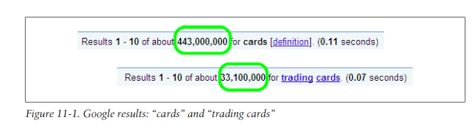
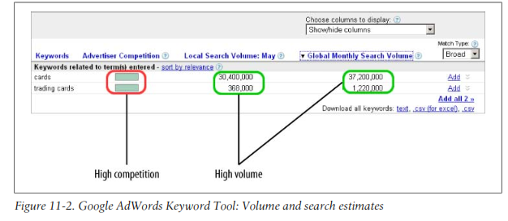
Keyword Strategy

Slide 18
Keyword Strategy
You can go after two different types of keywords:
broad and
narrow
Broad keywords : are extremely competitive.
Narrow keywords are typically attributed to much lower levels of competition.
Long tail keywords
Represent the narrow keyword spectrum.
They are multiword keywords that are highly specific and narrow in focus.
Although long tail keywords do not enjoy the same volume of search traffic as broad keywords, they do enjoy other benefits, such as higher conversion rates and lower competition.

Slide 19
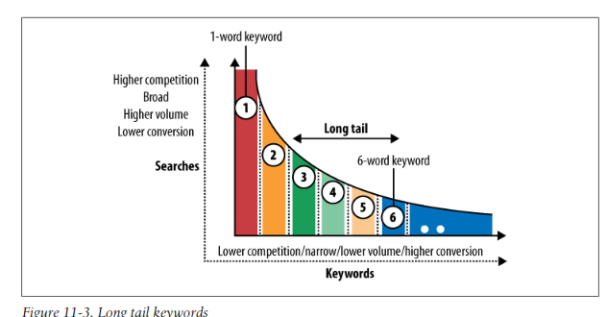
Keyword Strategy

Slide 20
Word Stemming
Word stemming refers to the concept of various word derivations from their basic (root) stems.
This concept is important, as using it can help in perceived page relevance.
Using multiple-word variations can assist you in attaining additional targeted traffic.
Keyword stemming is a useful tool for web pages and search engine optimization. The process of keyword stemming involves taking a basic but popular keyword pertaining to a particular website and adding a prefix, suffix, or pluralization to make the keyword into a new word.

Slide 21
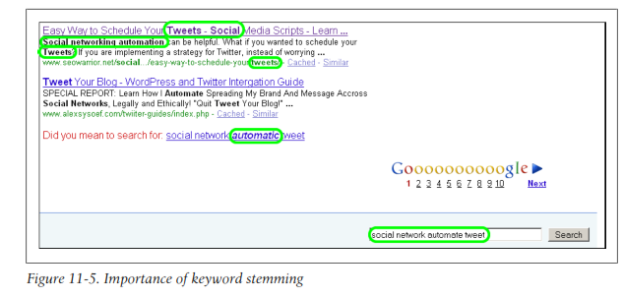
Word Stemming

Slide 22
Word Stemming
Even if your keyword is not an exact match, if it contains either the stem or its grammatical derivative, Google will rank your pages, as they will be perceived as relevant.
If your keyword is an exact match, this will typically translate to enhanced page rankings.

Slide 23
Keyword proximity
The keyword proximity refers to the distance between the search term's individualkeywords. For example: a website contains the keywords that make up the search term “dentist Boston implant” in the heading “Your professional dentist in Boston; dental practice for minimally invasive implants”.

Slide 24
Keyword Promence
In search engine optimization (SEO), this refers to the prominent placement ofkeywords or phrases within a Web page. Prominent placement may be in the page header, meta tags, opening paragraph, or start of a sentence.

Slide 25
Keyword Modifiers
Keyword modifiers are words that are used adjacent to your core (root) keywords.
Keyword modifiers can help strengthen your long tail keyword strategy.
The easiest way to find appropriate keyword modifiers is to start with your basic root words

Slide 26
Keyword Modifiers: types
Generic modifiers can be used on any site. These modifiers are usually part of popular search queries.
Money modifiers are typically used to catch searches with buying intentions.
Niche modifiers are modifiers that are specific to a particular industry.

Slide 27
Keyword Research Process
What would someone type to get to your site?
What keywords are associated with your line of business?
What would you type to find products, services, and information you are trying to sell?

Slide 28
Keyword Research Process
It includes
Establish a Current Baseline
Compile a Draft List of Keywords You Wish to Target
Keyword brainstorming
Utilize keyword stemming
Make use of generic keyword modifiers.
Continue by finding related keywords.
Finding related keywords
Make use of Microsoft Word
Using search engine keyword suggestions and related searches
Use keyword suggestion tool
Evaluate Your Keywords
Estimating keyword competition, revisited
Estimating keyword search volume
Finalize Your Keyword List
Implement Your Strategy

Slide 29
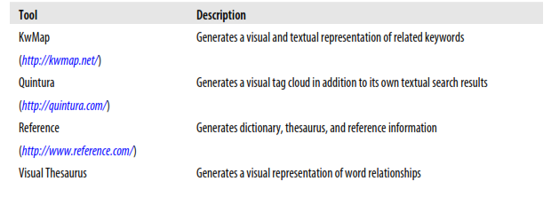
Keyword research tools
Google AdWords Keyword Tool.
Microsoft adCenter Labs
Yahoo! keyword tools
(Need to study in detail from book)
Additional keyword research tools

Slide 30
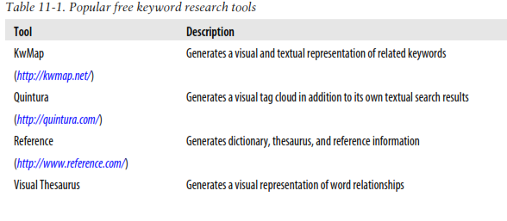
Keyword research tools
Additional keyword research tools

Slide 31
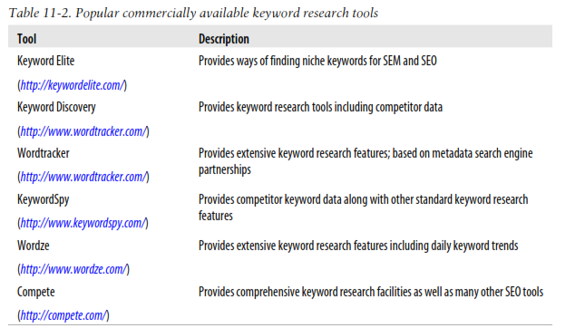
Keyword research tools
Additional keyword research tools

Slide 32
Link Building

Slide 33
Link Building
It helps increase your site’s public awareness while also helping you attain higher search engine rankings.
The number of inbound links to your site is a measure of its popularity.
Each backlink is a vote for your site.
All votes count, but search engines do not view them in the same way.
Focus your efforts on links that will bring in the most value to your site.
The most effective way to build great links is to build great content.
Creating open source software, a free service, a browser plug-in, interesting content, a web comic, or any other value-add feature will work.

Slide 34
Link Building
Internal link-building activities include the creation of link bait.
Ex: website widget
use the social bookmarking
Using website syndication

Slide 35
Precursors to Link Building
Start Building Your Reputation Early
stay in touch with your contacts through blog , social media etc.
When you are ready, let them know what you are working on and ask them to help promote your new site by adding links on their sites.
Assess Your Current Situation
If you are just starting with a new website, assessing your current situation should be fairly straightforward.
If your site is not live yet, you may still have some links pointing to it.

Slide 36
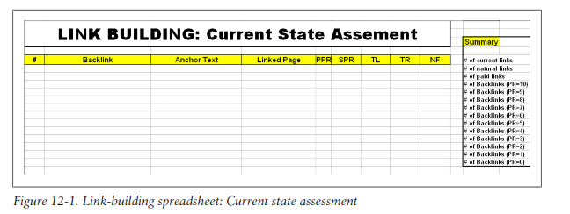
Precursors to Link Building
Assess Your Current Situation
If you are working with an existing site, it is important to evaluate the current state of your inbound links using any tool like Google Analytics, Google Webmaster tools etc
Aggregate this information in a list so that you can get a baseline before starting your new link-building campaign

Slide 40
Precursors to Link Building
Emulate Your Competitors
Assess the inbound links your competition uses.
Try to figure out their relative worth.
Find out how many pages are linking to the page containing the inbound competitor link.
Look at the overall site popularity, age, inbound links, estimated traffic,and so forth.
Find sites that are better, and get your inbound links placed on those sites.
use an aggregate of methodologies found on several high ranking sites.

Slide 41
Precursors to Link Building
Emulate Your Competitors
After examining your competition and analyzing your current state, you are ready to formulate some link-building goals. Shoot for the stars, but be realistic.
Optimize your time by going after links that will provide most of the benefits.
Go after reputable,authoritative, and noncompeting sites that are related to your site.

Slide 43
Precursors to Link Building
Natural Link Acquisition
This is something any site owner should desire: having a site that is so infectious that it becomes the buzz.
Link Sources and Link Quality
You need to ensure that your link-building campaigns are targeting many different sites to make your inbound links look more natural.
High-quality inbound links originate from topically similar pages.
The best inbound links appear on pages that rank well for your targeted keywords.
High-quality links also appear on pages with few or no ads or other links.

Slide 44
Types of Link Building
Using Content to Attract Links
Marketing Content for Link Acquisition
Content syndication: Guest posting
Social news and social sharing sites
Social media
Spreading content via blogs
Directory
The key to success in link building via directories is to identify the high-quality ones and stay away from the poor-quality ones.
Types of directories:
Directories that provide sustainable links
Directories that pass link juice that may not be sustainable
Directories that do not pass link juice

Slide 45
Types of Link Building
Incentive-Based Link Requests
use an incentive as part of the process of requesting a link
Content syndication
Widgets

Slide 46
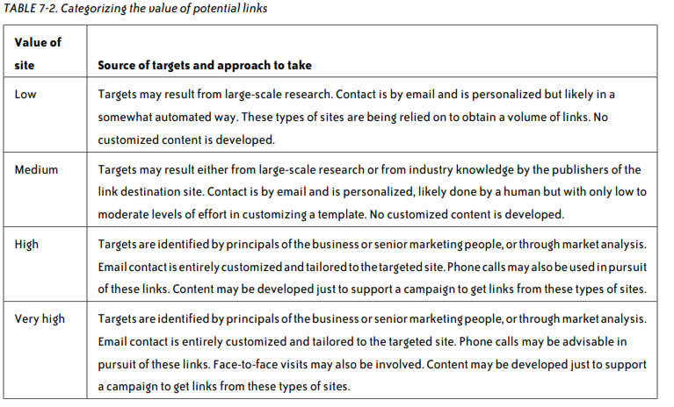
Types of Link Building
Direct Link Requests

Slide 47
Types of Link Building
Manual Social Media Link Creation
Gray Hat/Black Hat
Buying links for SEO
It is easy
Can choose Anchor text
Methods for buying links.
Direct link advertising purchases
Link brokers
Charitable donations

Slide 48
Choosing the Right Link-Building Strategy
Outline of a Process
Identify types of sites that might link to a site like yours
Why would these sites link to us?
Find out where your competitors get links
The key focus is to extract data from the competitors’ backlinks that helps you decide on your overall link-building strategy.
Review your website assets
review what you have on your site and what you could reasonably add to it
content needs to be unique and differentiated

Slide 49
Choosing the Right Link-Building Strategy
Outline of a Process
Identify any strategic limitations
Outline any limitations you may need to place on the campaigns
Identify methods for contacting potential linkers
undertake some activities to let potential linkers know about your site.
There are two major categories of methods: direct and indirect.
Some examples of direct contact methods include:
Email
Social media sites (using the messaging features of a social media property to make contact with potential linkers)
Blogger networking (building relationships by commenting on others’ blogs)
Phone calls
Seeking out publishers at conferences or meetups

Slide 50
Choosing the Right Link-Building Strategy
Outline of a Process
Identify methods for contacting potential linkers
Some examples of indirect methods include:
Social media campaigns (including Facebook, Twitter, Google+, Digg, Reddit, StumbleUpon, and others)
PR
News feeds (through Yahoo! News and Google News)
Speaking at conferences

Slide 51
Choosing the Right Link-Building Strategy
Putting It All Together
At this point, final decisions are made about the content strategy and which link-building targets to focus on
Execute aggressively
Publishers that execute aggressively inevitably gain an edge over many of their competitors.
Of course, if other competitors also focus heavily on link building, it becomes even more important to push hard, or else you will end up losing search engine traffic to them.

Slide 52
Choosing the Right Link-Building Strategy
Putting It All Together
Create a link-building culture
Publishers should train many people within the organization about their link-building plan, its goals, and how it will help the business.
The purpose of this is to engage the creativity of multiple team members in feeding the stream of link-building ideas.

Slide 53
Choosing the Right Link-Building Strategy
Putting It All Together
Conduct regular strategic reviews
As the implementation of link building strategy moves forward, lessons are learned, and this information can be fed back into the process.
New strategies are also conceived over time, and some of these are great ones to pursue. Also,
Publishers should have a constant stream of ideas that they are feeding into their link-building plans.

Slide 54
Choosing the Right Link-Building Strategy
Putting It All Together
Never stop
Link building is not something you do once, or once in a while.
Publishers who are lucky enough to get in front need to be prepared to fight to stay there.
Publishers who are not out in front should fight to get there.

Slide 55
Approaches to Content-Based Link Acquisition
Content Syndication
The concept behind content syndication is developing content with the intent of publishing it on someone else’s site.
In return for providing the content, the author gets a link back to her site.
This is sometimes referred to as guest posting, as blogs are often the target destination for such content.

Slide 56
Approaches to Content-Based Link Acquisition
Content Syndication
One variant of content syndication :article directories.
When syndicating content, it is a best practice to focus on high-value targets.
Sites that will take any article with little editorial review are not likely to offer high-quality links. In fact, the links may be of no value at all.
Getting into higher-value sites, such as that of a major regional newspaper, may require more effort, but these sites also provide high value

Slide 57
Approaches to Content-Based Link Acquisition
Leveraging User-Generated Content
Providing users with ways to contribute content directly to your site can be an effective tactic. There are many ways to do this:
Opening up a forum or allowing comments on your site
Launching a blog and inviting third-party contributors
More selectively inviting third-party contributions

Slide 58
Approaches to Content-Based Link Acquisition
Creating Link Bait/Viral Content
Link bait is the term that some use to refer to the notion of creating content for the specific purpose of acquiring links.
It is easy to come up with content that people will want to link to, but it does take some effort to come up with the right kinds of ideas.

Slide 59
Approaches to Content-Based Link Acquisition
Creating Link Bait/Viral Content
Here is a four-step process for coming up with and picking ideas:
Write down everything
Break down your ideas:break down each idea into its Concept and Content components.
Evaluate the content.
Mix and match
One should Encourage link bait to spread virally

Slide 60
Elements of Link Building: Basic Elements
Take out the guesswork
Take out the guesswork for your web visitors by providing the HTML code fragment(s) for people to link to your site.
Ex: Create “Link to Us” and “Tell a Friend” links.
Run a daily, weekly, or monthly email newsletter
Provide registered services

Slide 61
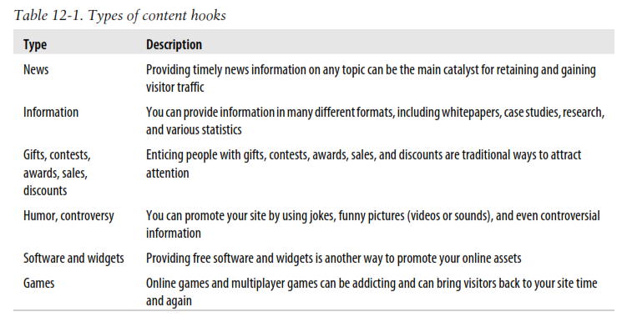
Elements of Link Building: Link Bait

Slide 62
Elements of Link Building: Link Bait
The terms link bait and link baiting describe the concept of creating interesting content with the intent of creating maximum Internet buzz to get as many people to link to your site as possible.
Having great content is your most basic link-baiting technique. You can also think of link bait as content “hooks.”
All forms of link bait have one thing in common: they promote your name, site, and brand.

Slide 63
Elements of Link Building: Link Bait
Website widgets to create link bait
Website widgets are simple, self-contained, value-added units of functionality.
They are typically confined to small blocks of screen real estate on one or all the pages of your site.
Any information that you can package in a way that provides unique value to other sites can be made into a widget.

Slide 64
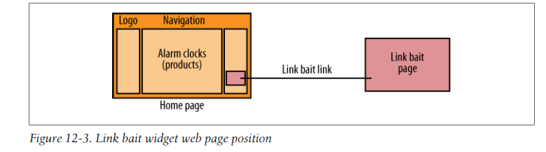
Elements of Link Building: Link Bait
Website widgets to create link bait

Slide 65
Elements of Link Building: Social Bookmarking
Social bookmarking is the concept of adding (typically) article and media bookmarks across various social bookmarking sites.
It is a way to store and access bookmarks from anywhere.
Everyone benefits in this model. Publishers get a wider audience and web users enjoy fresh, popular content.

Slide 66
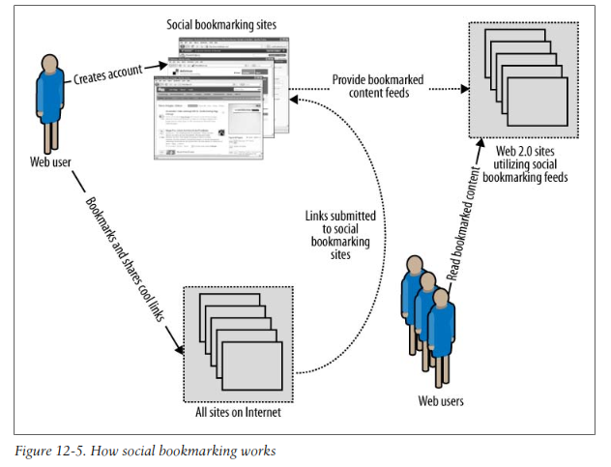
Elements of Link Building: Social Bookmarking

Slide 67
Elements of Link Building: Website Syndication
Website syndication is the de facto standard for content publication.
Syndicated content provides a medium to reach a greater subscriber audience.
Subscribers use tools such as Atom and RSS feed readers to stay abreast of newly published content.
When users subscribe to your feeds, you have a unique opportunity to keep them interested in your site.
One can use it as a teaser, those who want to read the entire article can visit your site.
When they come to your site, they will also see other elements of your site that will hopefully produce additional clicks.
Two of the most popular syndications types are Really Simple Syndication (RSS) and Atom.

Slide 68
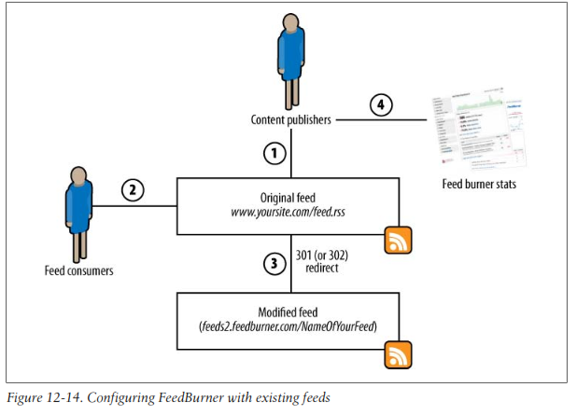
Elements of Link Building: Website Syndication

Slide 69
Elements of Link Building: Directories
Ensure that your targeted directories will pass link juice.
Choose proper directory category (Look for less crowded categories for optimal link juice transfer. Also see what their PageRanks are for their home pages)
Spend your time first on directories with the highest PageRank.

Slide 70
Elements of Link Building: Adding Your Links Everywhere
Submitting articles
Utilizing blog comments, newsgroups, and forum postings

Slide 71
Elements of Link Building: Build a Complementary Site
You want to create a complementary content-rich site that targets many other keywords not specifically targeted on your main site. This is not a call to create duplicated content.
Niche directory hubs
Awards websites
Site review websites
Site software

Slide 72
Incentive-Based Link Marketing
Providing an incentive for people to provide a link back to you can work well.
Of course, you need to do this with care, because there are incentives that would be indistinguishable from the outright
You can also try to implement programs to stimulate the discussion in forum, such as offering a prize on a monthly basis for a randomly selected contributor.

Slide 73
Incentive-Based Link Marketing
Helping Other Sites Boost Their Value
You can get people to link to you because linking to you can enhance their site’s value.
One example of this is a program that gives sites awards for excellence of some kind. This is particularly effective if your site is a respected authority in your space.
Another example is various forms of certification. For example, Google has badges for its AdWords Qualified Professionals and AdWords Qualified Companies, with links back to Google.

Slide 74
Incentive-Based Link Marketing
Offering Customer Discounts/Incentives
Publishers can offer visitors from certain websites a discount on their products.
Sites that want to offer the discount to their users simply need to link back to the publisher’s site.
However, Google also sees this as a questionable practice.

Slide 75
Fight Link Spam
Algorithmic Approaches to Fighting Link Spam:
The major approach the search engines use is to design algorithms that can detect and act on link spam. Here are dew algorithmic representative :
Links labeled as advertisements
The search engines can scan for nearby text, such as “Advertisement,” “Sponsors,” “Our Partners,” and so on.
Sitewide links
In general, sitewide links are a serious flag, especially if you have a lot of different sites that do this for you, or if a large percentage of your links are sitewide.

Slide 76
Fight Link Spam
Algorithmic Approaches to Fighting Link Spam:
Links sold by a link broker
Selling site has information on how to buy a text link ad
Search engines can detect sites that provide information on how to advertise with them.
Relevance of your link
It is a powerful clue if your link is not really that relevant to the page or site it is on.
Quality of neighboring links
Location outside main content

Slide 77
Fight Link Spam
People who might report as spam:
Someone reports your site for buying links or for some other reason: competitor
Someone reports the site you bought links from for selling links or for some other reason:competitor
A disgruntled employee leaves your company, the broker, or the site you bought links from and reports your site
A search engine employee does a manual human review of your site

Slide 78
Content Considerations

Slide 79
Short-Term Content
Short-term content is the current Internet buzz.
Sites producing such content include blogs, forums, and news sites.
Short-term content is important, as it aids webmasters by providing a freshness and relevancy boost to their websites.
Unexpected buzz
The trick when creating short-term content is to do it while the specific topic is still “hot.”
Better yet, if you can anticipate the future buzz the content will generate, you will be a step ahead of your competition.

Slide 80
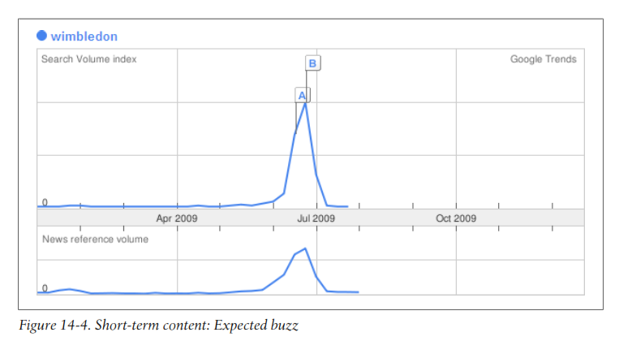
Short-Term Content
Expected buzz

Slide 81
Short-Term Content
Expected buzz
Creating short-term content of expected events is much easier than doing the same for unexpected events.
However, you will be facing a lot more competition for the same storylines.

Slide 82
Long-Term Content
It is the type of content that people bookmark and come back to many times.
This type of content has a greater lifespan than shortterm content.
Its relevancy does not diminish much over time.
Long-term content can be anything from online software tools to websites acting as reference resources.

Slide 83
Long-Term Content
Ex: You can see that the overall search volume is more or less the same month after month. If your site hosts the best “HTML Tutorial” around and is currently getting good traffic, you can be pretty certain that your site will be getting steady traffic in the future

Slide 84
Content Balance
How much of your content is short term or long term depends on your line of business.
If you are in the news or blog business, you will do well by continuously producing new content.
If you are providing technical information, you may wish to offer a mix of new articles and technical reference articles, which you can package into a different article category that is easy to access from anywhere on your site.

Slide 85
Content Creation Motivation
The ultimate motive of any website content is to provide information to visitors so that they can accomplish a particular business goal.
Engaging your visitors
Modern sites try to make it easy for their visitors to comment on and share their content.
Fortifying your web authority
Creating a continuous buzz and interest is necessary to foster and cultivate your brand or business.

Slide 86
Content Creation Motivation
Updating and supplementing existing information
You need to ensure that your site is on top of the latest happenings in your particular niche.
Catching additional traffic
Create additional unique content to get more traffic

Slide 87
Content Duplication
Different ways to deal with content duplication :
Canonical Link Element
A canonical link is like a preferred link.
This preference comes to light when we are dealing with duplicate content and when search engines choose which link should be favored over all others when referring to identical page content.
http://www.mydomain.com/pants.html, which you want to be the preferred page, as it points to the original (main) document.

Slide 88
Content Duplication
Canonical Link Element
But you also have three other pages that refer to the same content page, as in the following:
http://www.mydomain.com/catalog.jsp?part=pants&category=clothes&
http://www.mydomain.com/catalog.jsp;jsessionid=B8C2341GE57FAF195DE34027A95DA3FC?part=pants&category=clothes
http://www.mydomain.com/catalog.jsp?pageid=78234

Slide 89
Content Duplication
Canonical Link Element
To apply the newly supported canonical link element, you would place the following in each of the three preceding URLs, in the HTML header section:
<link rel="canonical" href="http://www.mydomain.com/pants.html" />

Slide 90

Content Duplication
2. Multiple urls
All requests will now be redirected (using the HTTP 301 permanent redirect) to the URL version with the trailing slash.

Slide 91

Content Duplication
3. Multiple Slashes

Slide 92

Content Duplication
Multiple urls
If you prefer not to use a trailing slash, you can use the following:

Slide 93

Content Duplication
4. WWW prefix

Slide 94
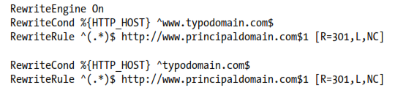
Content Duplication
5. Domain misspellings

Slide 95

Content Duplication
6. HTTP to HTTPS and Vice-versa

Slide 96
Content Duplication
External Content Duplication
Mirror sites
Content syndication
Similar Pages
If you have many pages that are similar, consider expanding each page or consolidating the pages into one.
Deep-Linked Content
Sitemaps
Resurfacing
Navigation structure

